Slide 1
MULTI-CUT REBAR(10)
Advisor : Prof. K.C.Chang
Presenters : You-Ran Nai

Slide 2
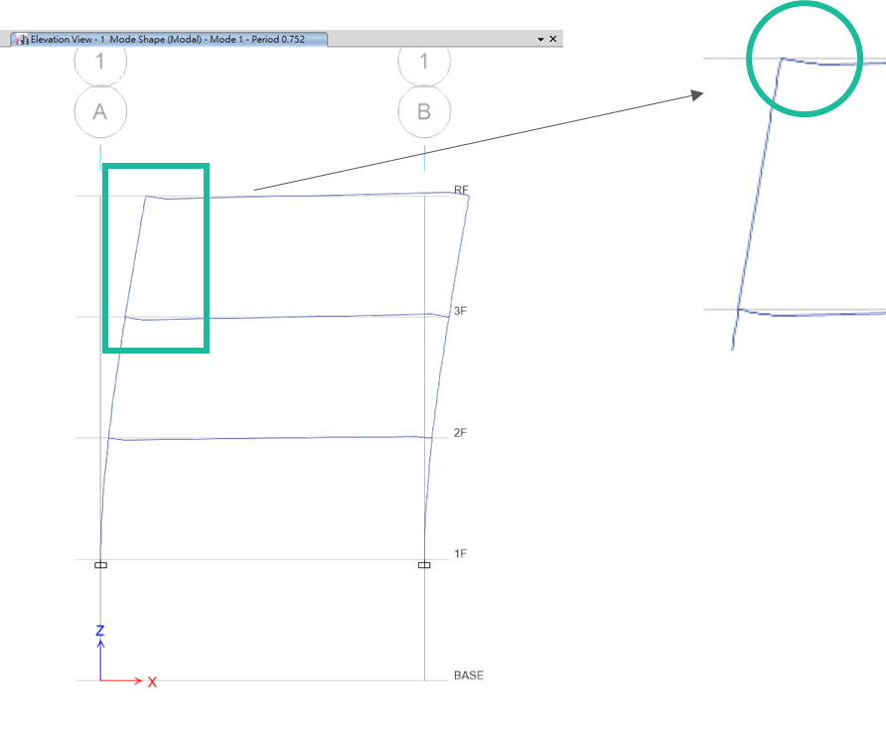
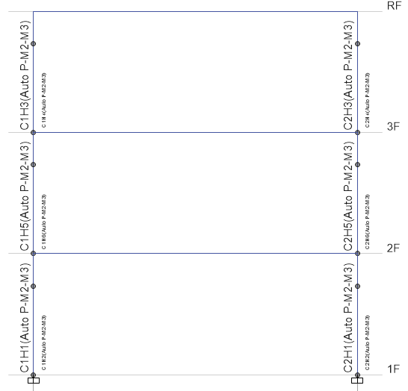
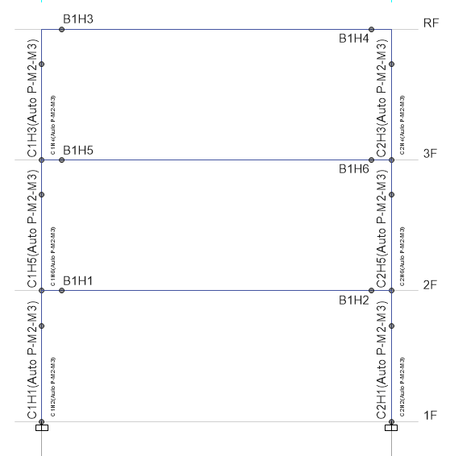
Nonlinear Hinge
ETABS 2016
No Nonlinear Beam Hinge
T=0.345
Nonlinear Beam Hinge
T=0.752
Nonlinear Beam Hinge

Slide 3
Nonlinear Hinge
Static Nonlinear
Fast Nonlinear Analysis (FNA) Modal Time History Analysis
Nonlinear Direct Integration Time History

Slide 4
P-Delta
ETABS 2016
P-Delta
No P-Delta
No Nonlinear Beam Hinge
T=0.345
No Nonlinear Beam Hinge
T=0.344
Nonlinear Beam Hinge
T=0.752
Nonlinear Beam Hinge

Slide 5
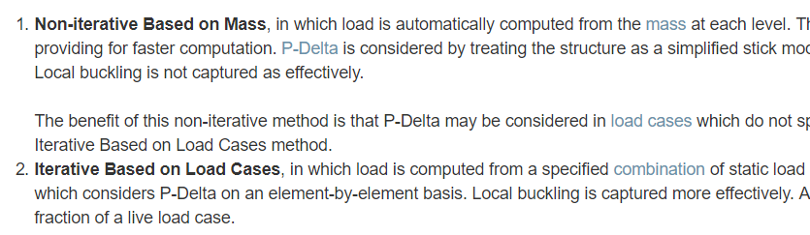
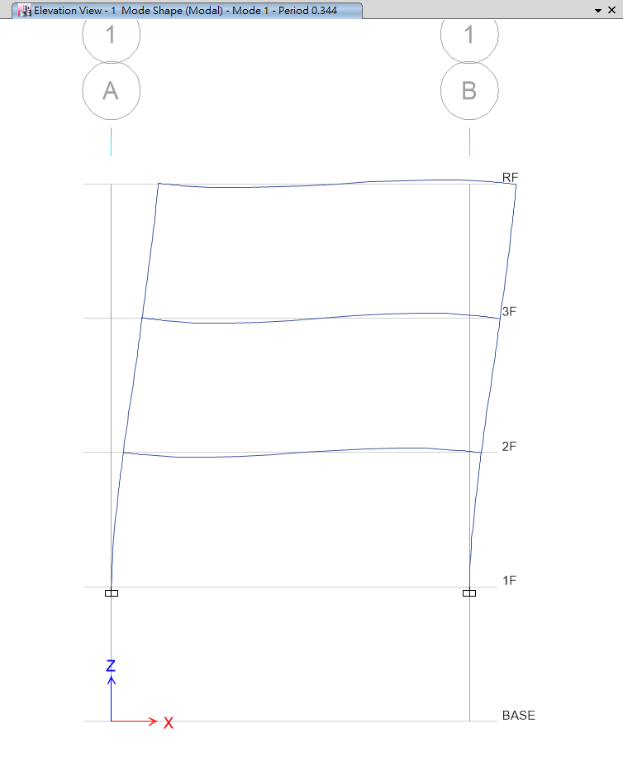
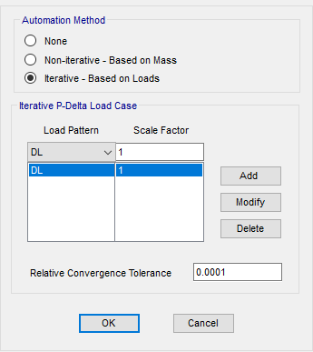
P-Delta
Local Buckling
RC ➔ SS

Slide 6
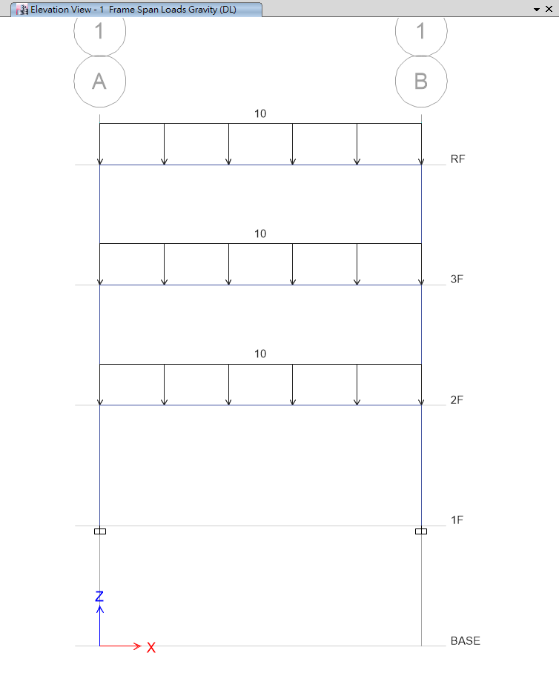
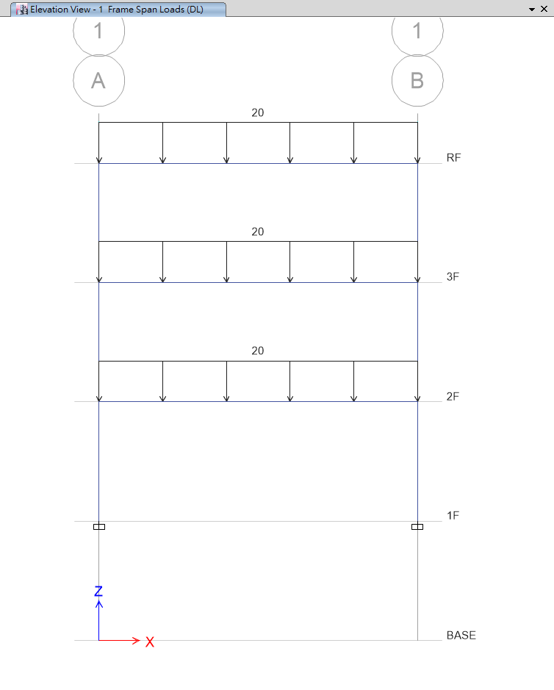
P-Delta
Steel Structure
10 ton/m
Same Period
20 ton/m
Different Period

Slide 7
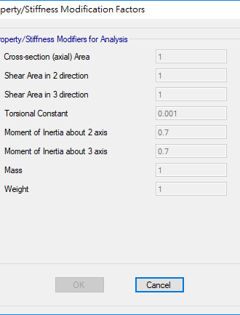
0.5, 0.7
Moment of Inertia
Same Problem

Slide 8
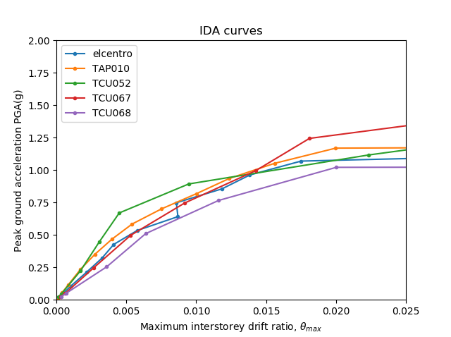
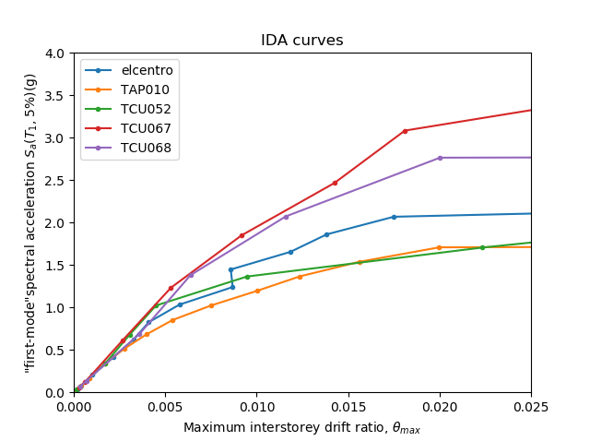
PGA versus Sa(T₁, 5%)
Less Dispersion

Slide 9
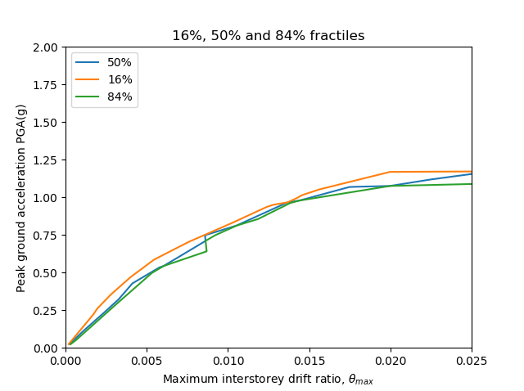
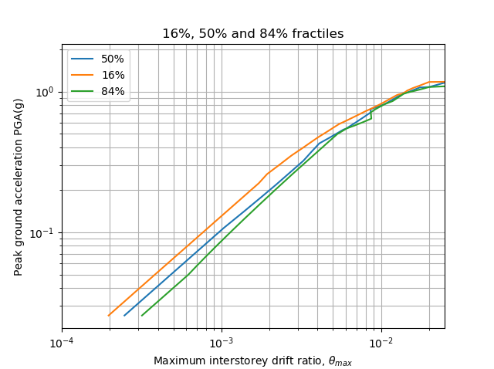
Linear
Log

Slide 10
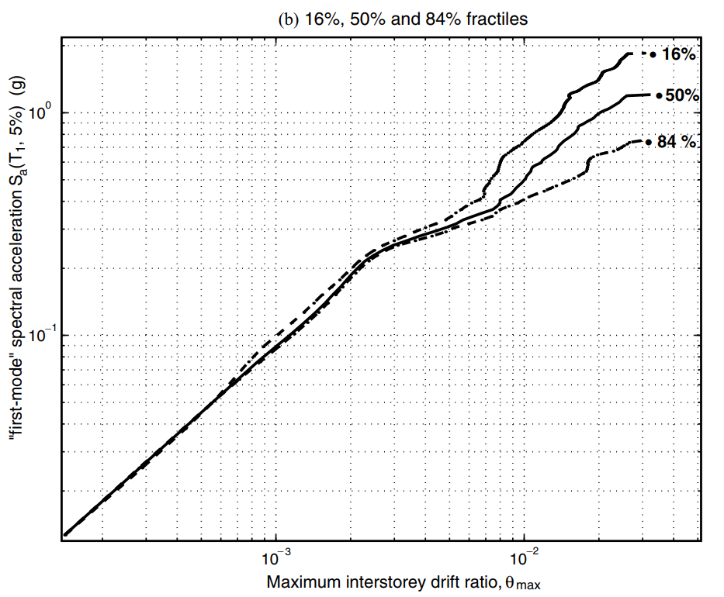
5-storey steel braced frame
3-storey rc moment resist frame
Elastic Closed

Slide 11
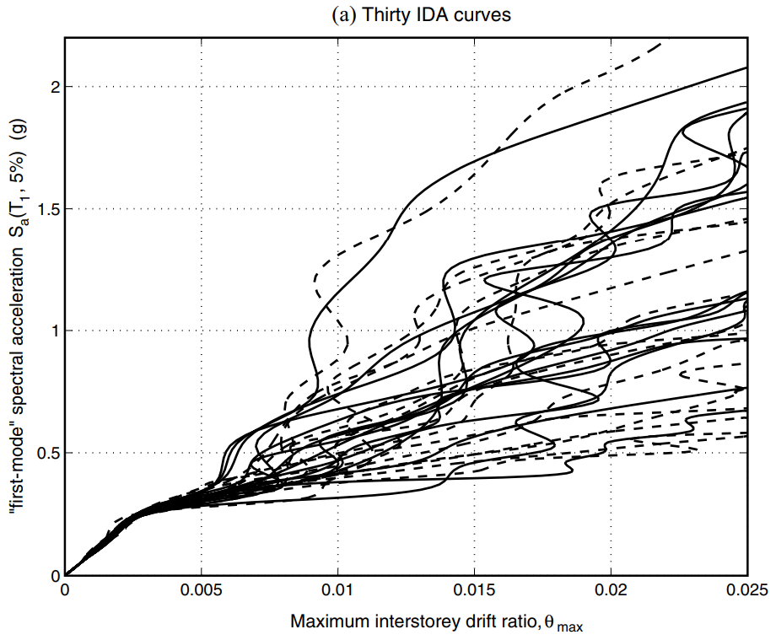
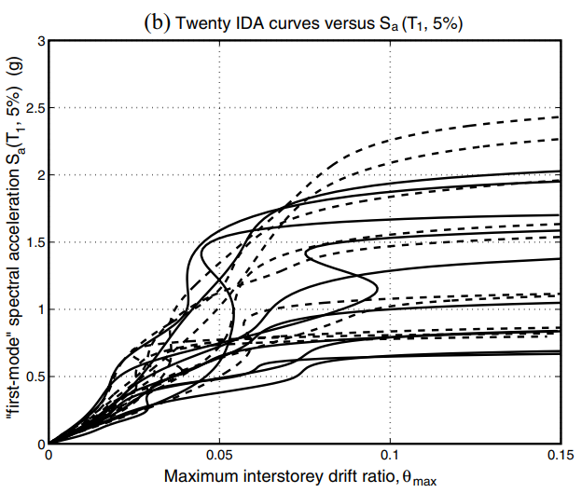

Slide 12
PGA versus Sa(T₁, 5%)
Less Dispersion
Elastic Closed

Slide 13
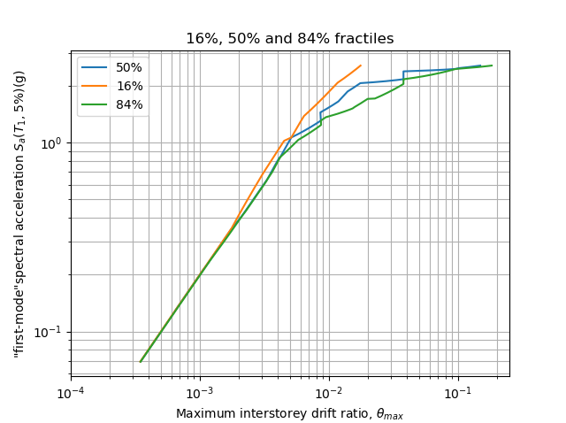
5-storey steel braced frame
3-storey rc moment resist frame
Elastic Closed

Slide 14
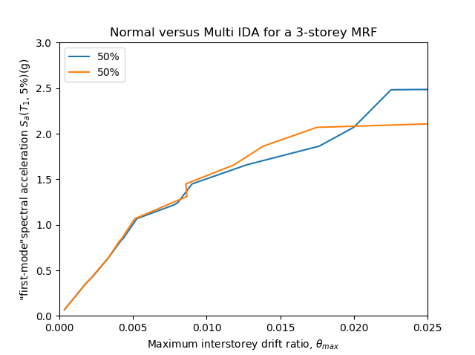
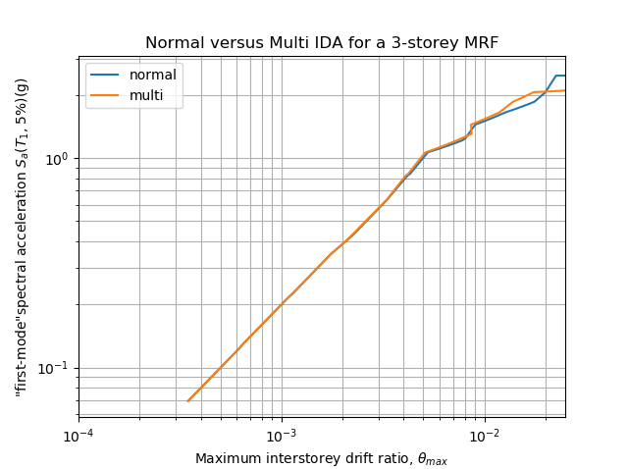
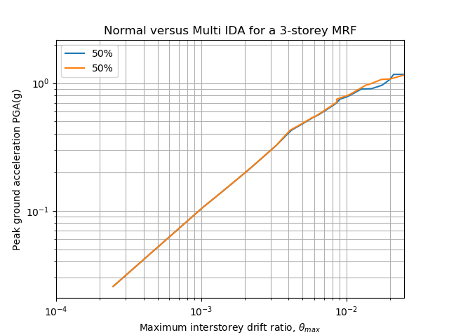
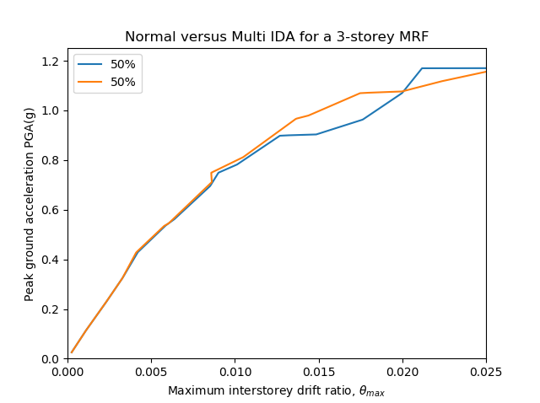

Slide 15
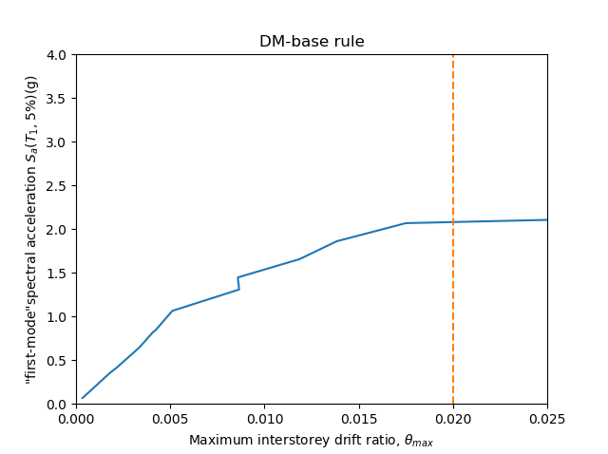
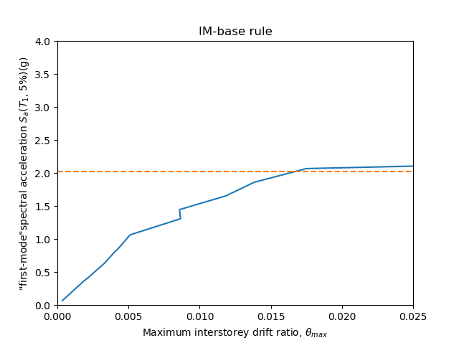
C_{DM} is set at 0.02
C_{IM} uses the 20% slope criterion

Slide 16
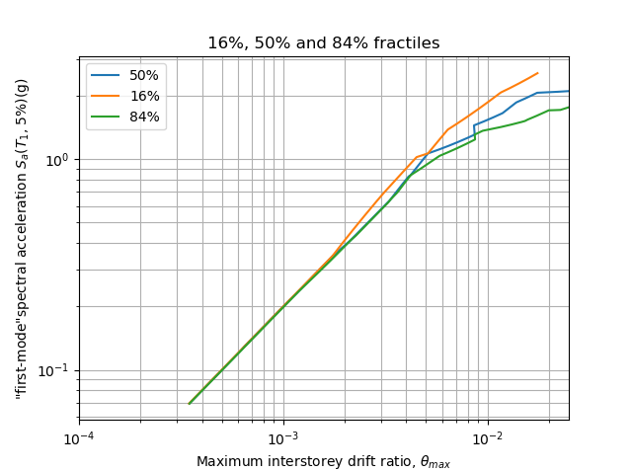
3-storey rc moment resist frame
P-Delta ➔ No P-Delta
Consider Structural Resurrection
➔ No Consider Structural Resurrection
Rough ➔ Detail ( Output Size, Scaled Factor… )
Elastic Closed

Slide 17
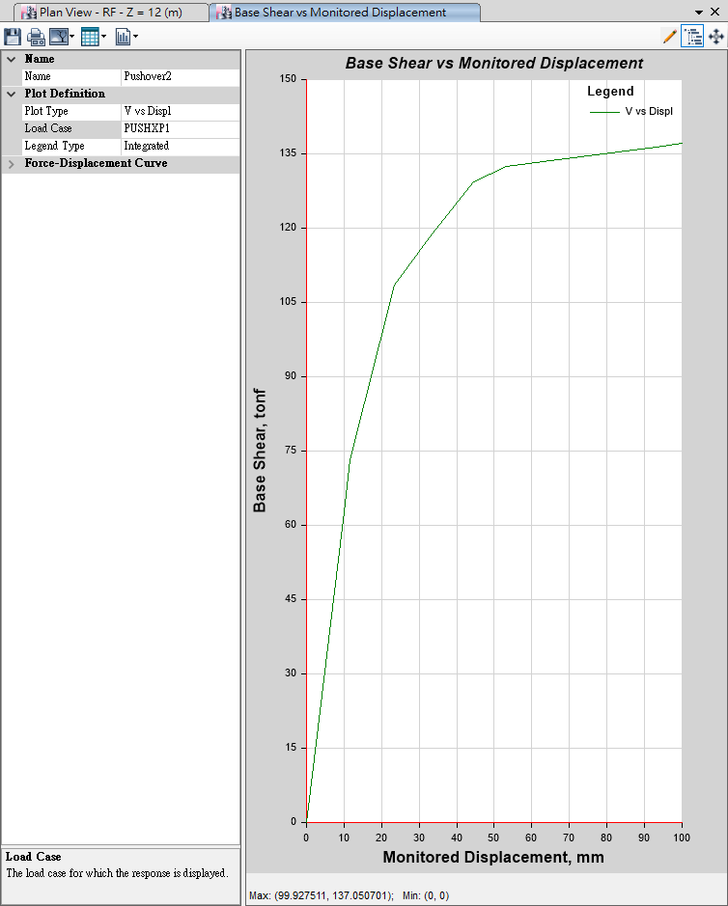
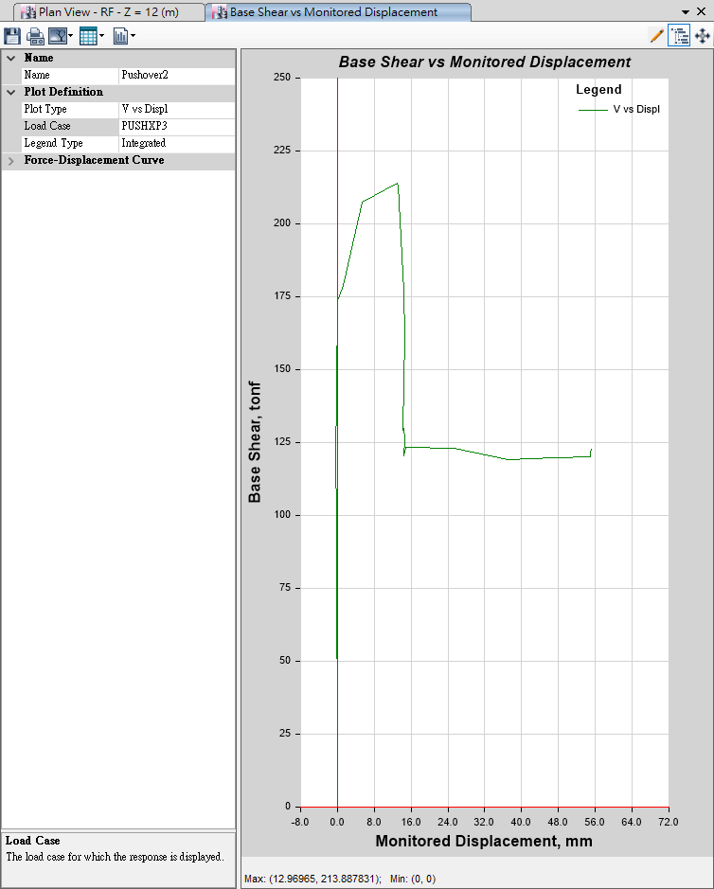
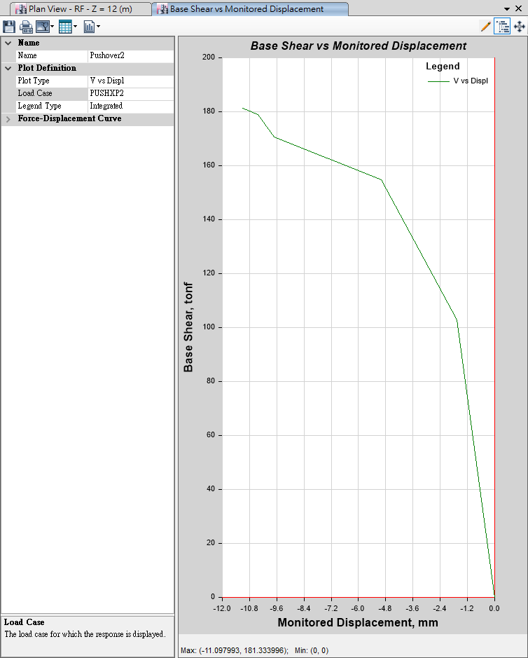
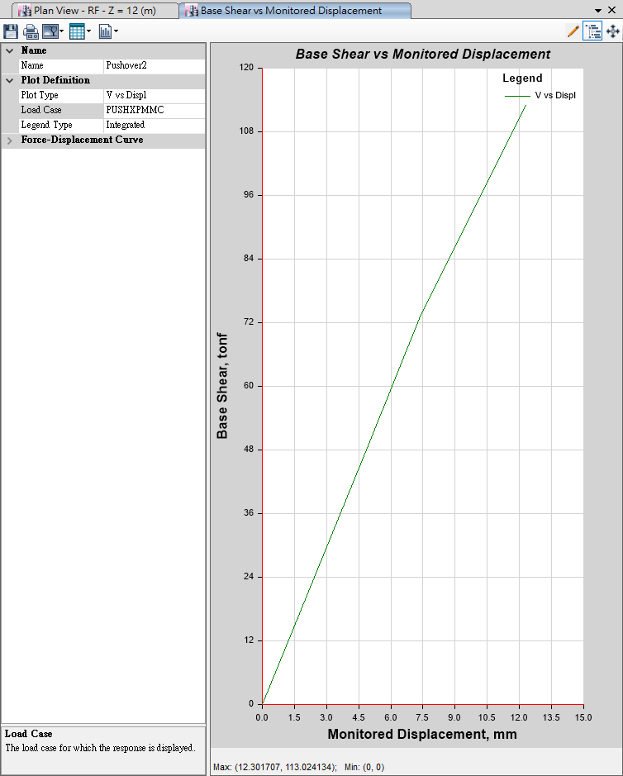
Pushover
Mode 1
Mode 3
Mode 2
MMC

Slide 18
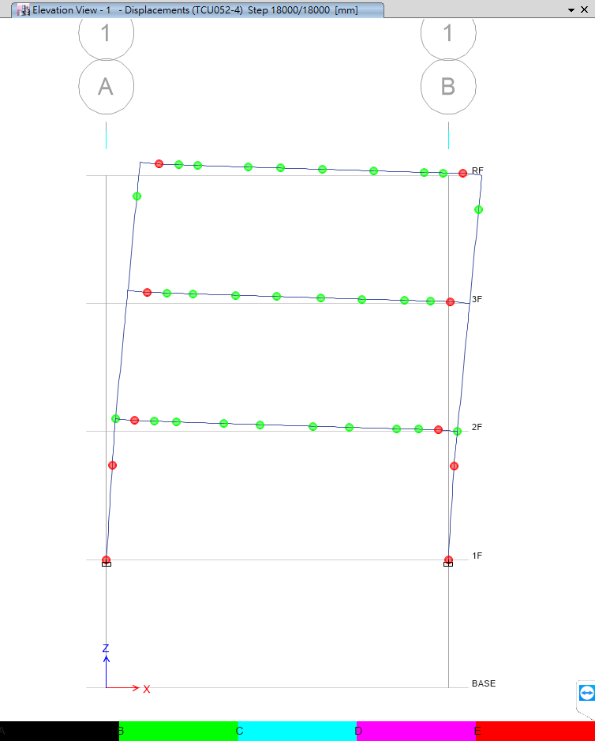
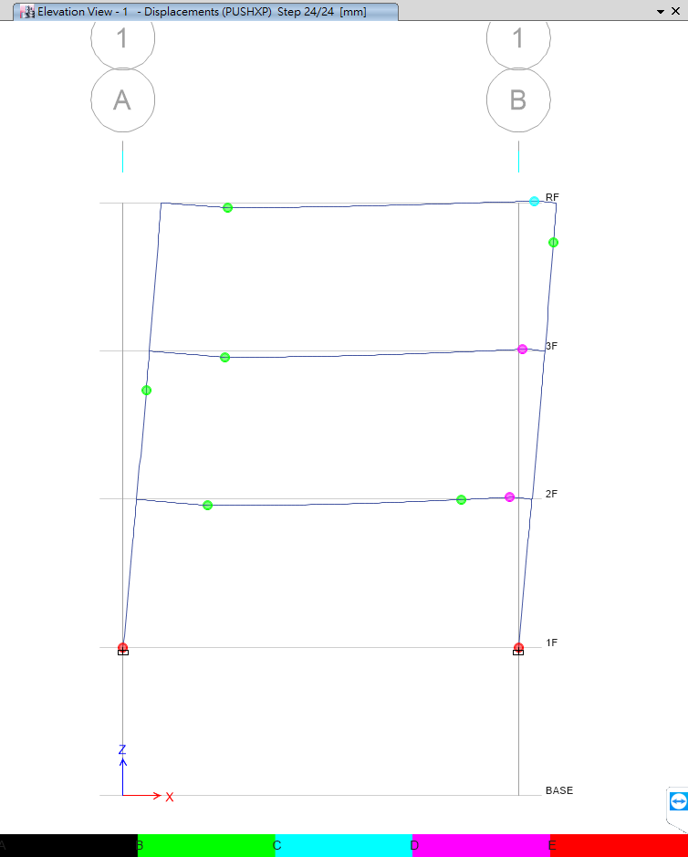

Slide 19
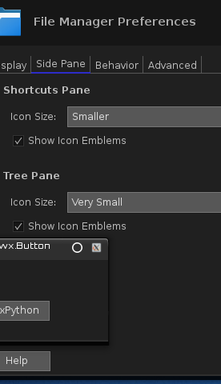
LinearCut GUI

Slide 20
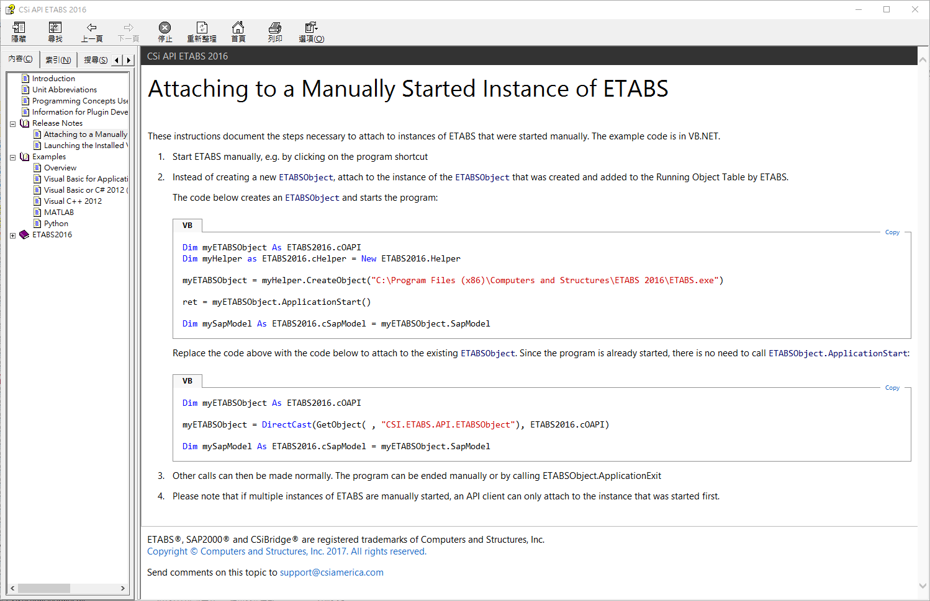

Slide 21
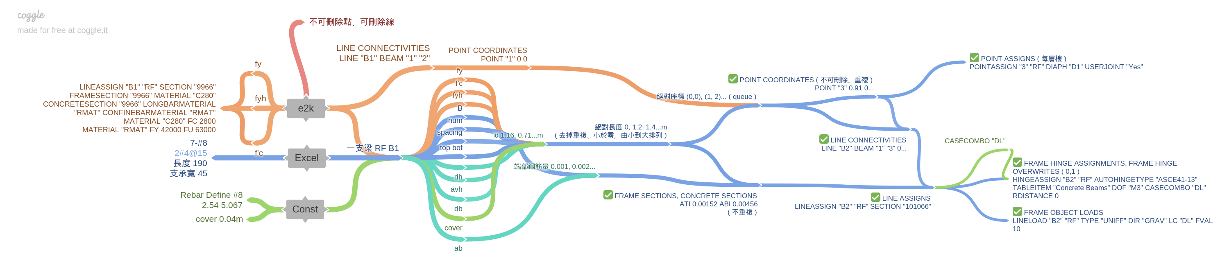
E2K versus API

Slide 22
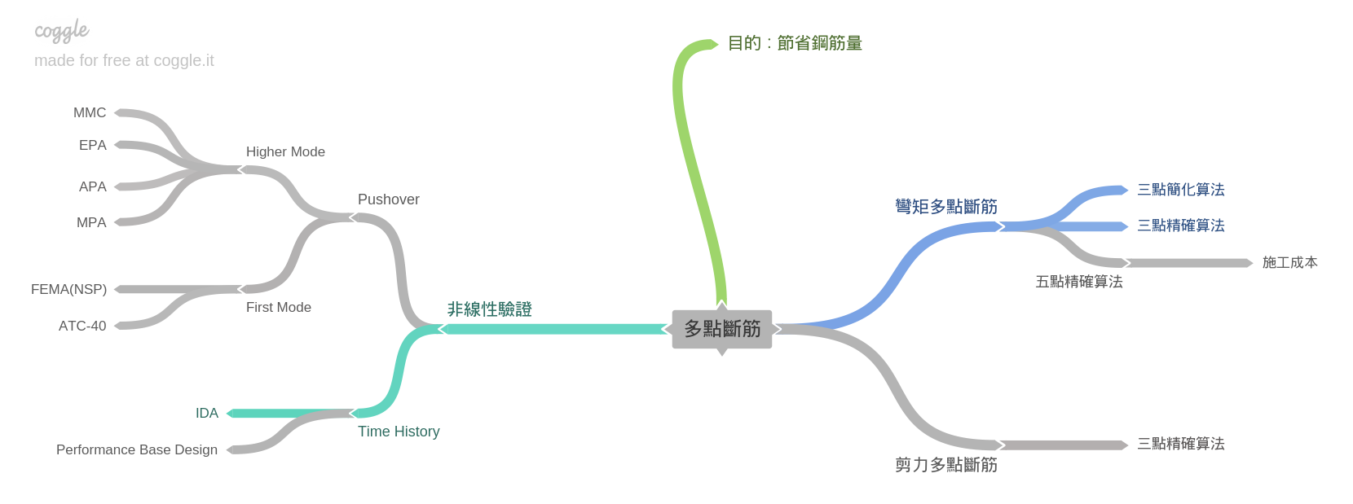
Roadmap

Slide 23
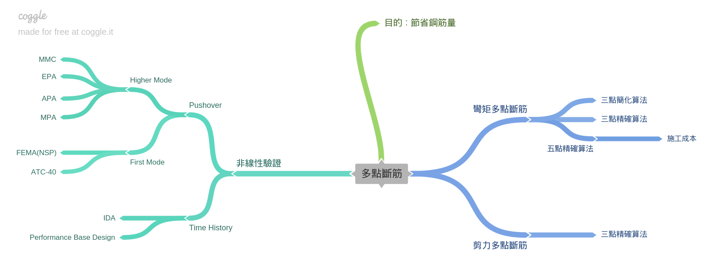
Roadmap

Slide 24
